Slide 1
Advanced Topics
Ishrat Jahan

Slide 2
Load Balancing

Slide 3
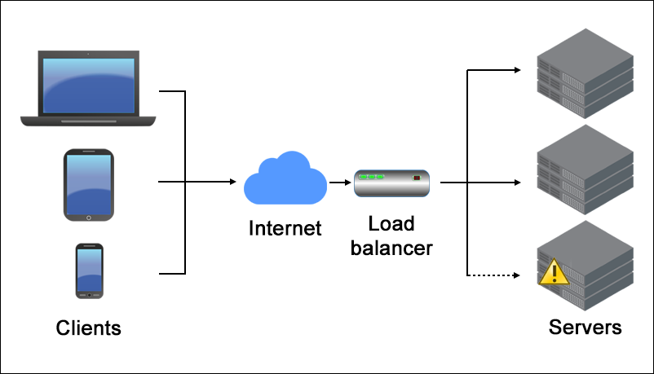
Load Balancing

Slide 4
High Availability
https://www.geeksforgeeks.org/introduction-of-virtual-router-redundancy-protocol-vrrp-and-its-configuration/

Slide 5
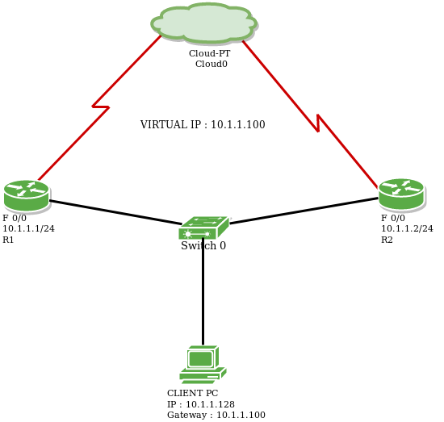
VRRP - Virtual Router Redundancy Protocol

Slide 6
Network Virtualization

Slide 7
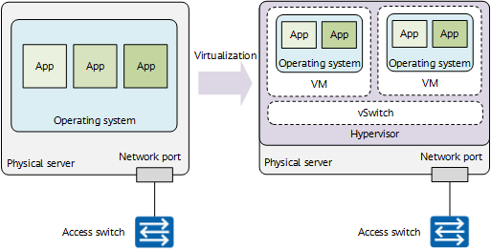
Server Virtualization

Slide 8
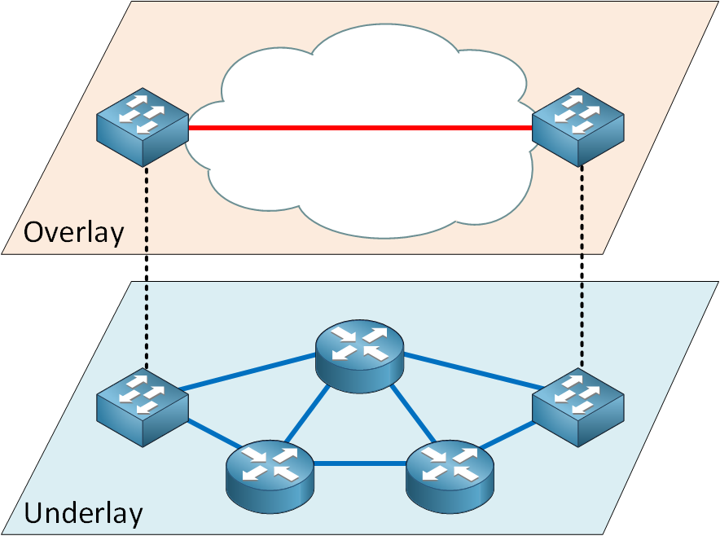
Network Virtualization (Overlay vs Underlay)
https://www.geeksforgeeks.org/network-virtualization-in-cloud-computing/

Slide 9
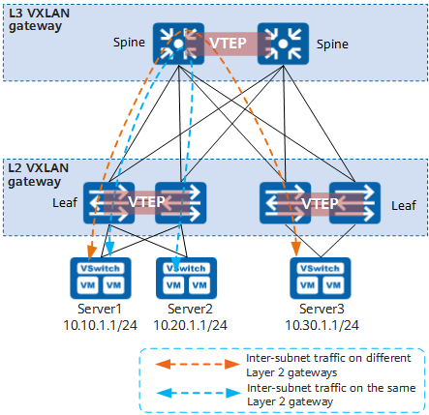
VXLAN
For details, please check this website.

Slide 10
